Slide 1
Attribute Learning System
Austin Cory Bart
K. Alnajar

Slide 2
What’s the problem?
Time
Inefficiency
Tricky

Slide 3
Possible Solution and design
Modifiers
Utility Criteria
Attributes
Genetics

Slide 4
Utility Calculation
Battle Victory
Move Usage
Move Utility

Slide 5
Looking at Genetics
Mutations
Crossovers
Genetic Algorithm

Slide 6
Genetic Types
method1
Trees
method2
Vectors

Slide 7
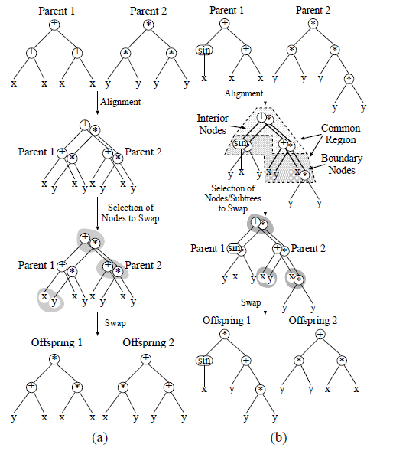
Method 1 – function Tress
TREE.CROSS_OVER
Swap corresponding interior node of one tree with that of another tree
TREE.MUTATION
Mutate leaf nodes and parents of leaf nodes of the tree, either by replacing a node with a child node or by replacing the node with a different type.
Poli R., Langdon W.B. On the search properties of different crossover operators in genetic programming. In J. R. Koza, et al., editors, Genetic Programming 1998:Proceedings of the Third Annual Conference, pages 293-301, University of Wisconsin, Madison, Wisconsin, USA, 22-25 July 1998.

Slide 8
Method 2 - Linear Transformations
VECTOR.MUTATION
Change the coefficient of a given attribute by some small amount
Allows for finer tuning and changes
VECTOR.CROSS_OVER
Find the average of a coefficient given a shared modifier

Slide 9
Final Discussion

Slide 10
Things That Did Not Work

Slide 11
The End.

Slide 12
What’s the problem?
Coming up with a good formula for a system which relies on attributes and modifiers can be tricky and time consuming
The most direct example is an RPG style game with various moves that effect things like health, defense and attack
Often times, may not be done right or not enough time is spent making it better than it could be due to cost
Ex. Final Fantasy VIII (draw magic attack) and Eternal Sonata (4 moves, can use 2 at only certain points)

Slide 13
Possible Solution and design
Design a system that creates moves based on effective usability
To do this, we propose a system that takes in certain criteria, performs a large set of simulations on the moves to determine effectiveness, and then uses a genetic algorithm to improve these moves
Two Methods:
Function Trees
Linear Transformations

